Slide 1
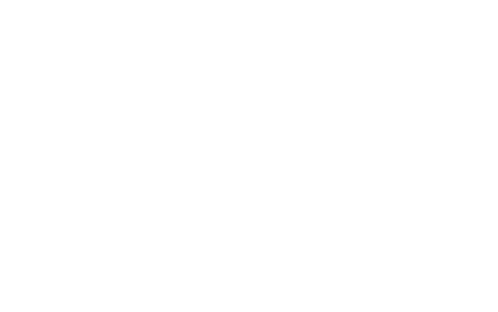


Slide 2

CO-AID
~A hospital management system

Slide 3

Mini project guide:
Members:
Vaidik Vadhavana
Sejal Yadav
Om Walanju
Shriya Vidwans
Prof.A.R.Kalugade

Slide 4
Abstract:
Today ,the world is not the world we knew, everything changed in the year 2020 because of dangerous virus called Covid 19 , to tackle it special wards were setup for it. It became difficult for the patients to get appointments of doctors for covid checkups , due to their busy schedule. To help patients get appointments of doctor we are making an GUI app called as CO-AID . It is as appointment scheduling app which can be used for a particular hospital. In this project, we use Python and SQLite database. A responsive web-app with aesthetic and accessible UI for managing COVID patients of a certain hospital.

Slide 5

Problem definition:
CoAid Hospital Management System is a software product suite designed to improve the quality and management of hospital management in the areas of clinical process analysis and activity-based costing. Hospital Management System enables you to develop your organization and improve its effectiveness and quality of work. Managing the key processes efficiently is critical to the success of the hospital helps you manage your processes. The project Hospital Management system includes registration of patients, storing their details into the system. The software has the facility to give a unique id for every patient and stores the details of every patient automatically which in turn makes easier to make appointment with the doctor.

Slide 6

Scope:
The modules of CoAid hospital management software are user-friendly and easy to access. It has a common user friendly interface. The officials can utilize these modules in their processes without any hassle and make the best possible use of hospital management system.

Slide 7
Features (Objectives):
The main objective is to develop Online Appointment Management tool that helps hospital admin manage their appointments.
It is a clean aesthetic User Interface, which changes dynamically as per the status of patient changes.
Here you can add patient details for storing it to the database.
You can also find update button to update the patient details.
System input contains patient details, while system output is to get these details on to the screen.
Easy access to patient data with correct patient history

Slide 8


Impact of our project on society:
The world of work has been profoundly affected by the global virus pandemic. In addition to the threat to public health, the economic and social disruption threatens the long-term livelihoods and wellbeing of millions.
In such a dreadful situation our project contributes a help towards the society by providing a suitable platform which would help in management of the hospital.

Slide 9

Existing System:
Hospitals currently use a manual system for the management and maintaince
of critical information.
The current system requires numerous paper forms, with data stores spread through out the hospital management infrastructure.
Multiple copies of the same information exist in the hospital causing confusion among the hospital staff.
EXAMPLE : PAPPYJOE , DOC PULSE .

Slide 10

Python
MySQL
Pycharm
IDE
Technical requirements

Slide 11
Our Logo:

Slide 12
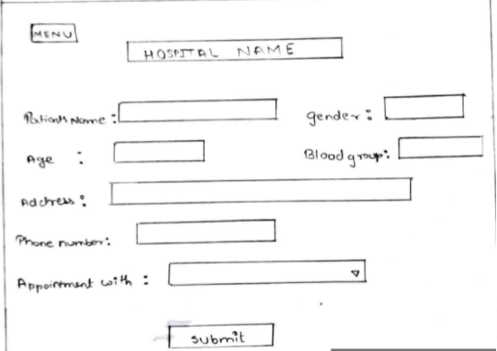
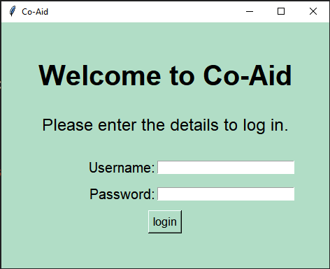
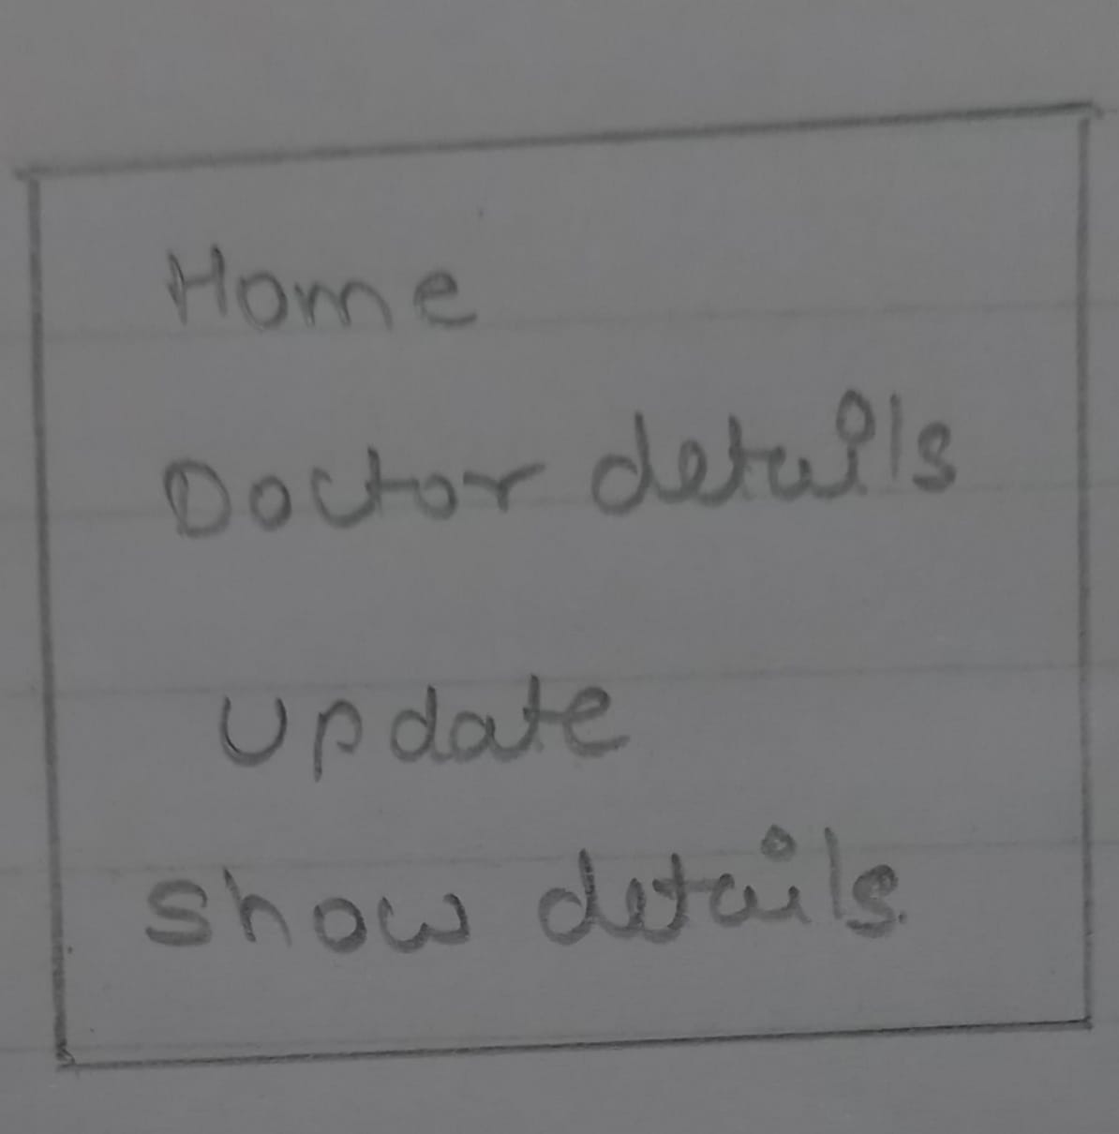
Project design:

Slide 13
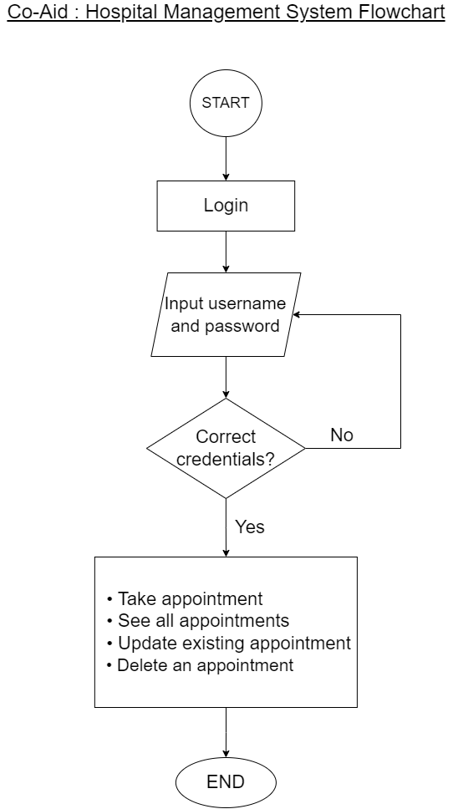
Flow of modules:

Slide 14

Thankyou
Stay safe ☺

